Slide 1

WEB SCRAPING TO GAIN COMPANY INSIGHTS
By: Muhammad Adamu Sani
1/10/2024

Slide 2
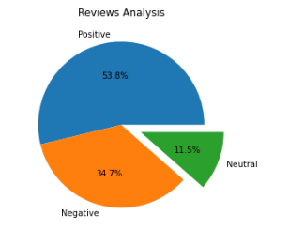
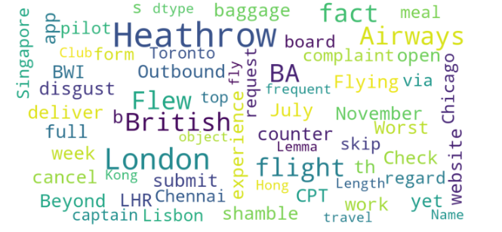
INSIGHTS FROM CUSTOMER REVIEWS
From cleaning 1000 reviews given by the customers, we obtained
Positive Reviews - 537
Negative Reviews - 346
Neutral Reviews – 117
Word cloud of keywords used in reviews

